Slide 1
Project 9: Drunk driving
Group 4
Artjom Hulsbergen
Ties Blokker
Luk Sullock Enzlin

Slide 2
Small self propelling particles
Bacteria and cells can create complex systems
Hard to predict
Minimum requirements for a system

Slide 3
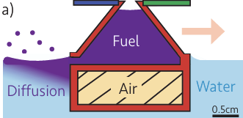
Marangoni-effect
Lowering the surface tension with the fuel
Ethanol, soap, etc.
Lower surface tension causes a force outward
Force outward results in the boat moving forward
Wilt, J. K., Schramma, N., Bottermans, J., & Jalaal, M. (2024). ActiveCheerios: 3D-Printed Marangoni-Driven active particles at an interface. arXiv (Cornell University).
https://doi.org/10.48550/arxiv.2411.16011

Slide 4
Goals
Primary:
Steering mechanism
Secondary:
Controllable fuel dispensation
Work on solar panels
Backup plan:
Sail straight

Slide 5
Challenges
Electronics need to be lightweight
Upscaling of the boat can lower the thrust

Slide 6
Things to test
Different materials
Different infill percentages
Carriable weight to size ratio
How straight the boat sails
Lifespan of the boats per size
Speed of the boats per size

